Slide 1


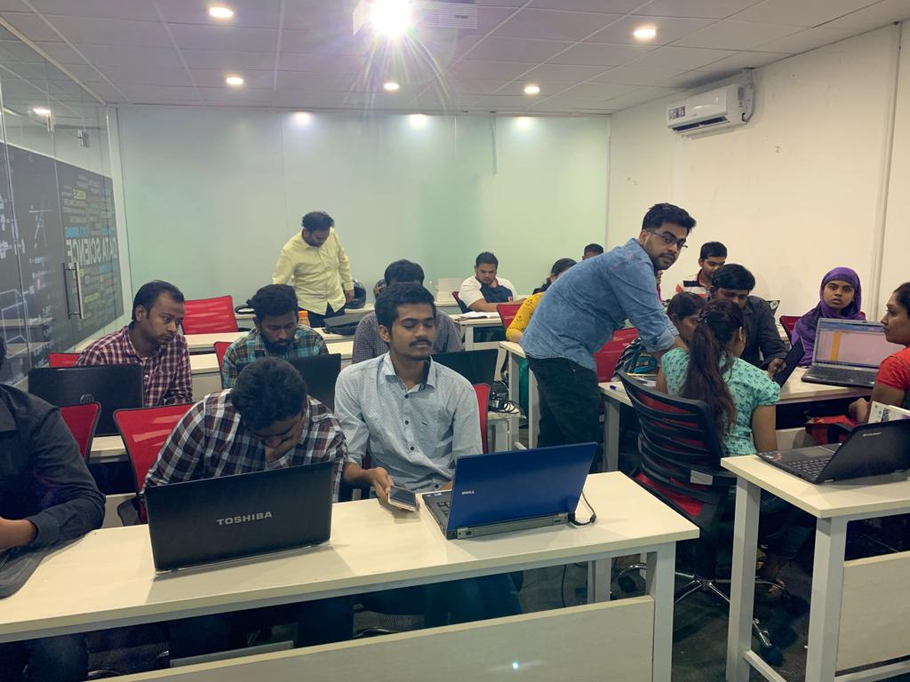





Slide 2
Music Recommender System TEAM-10
Under the esteemed guidance of
Himanshu Goswami sir

Slide 3
RECOMMENDER SYSTEM
A recommender system is a type of information filtering system. By drawing from huge data sets, the system ’s algorithm can pinpoint accurate user preferences. Once you know what your users like, you can recommend new, relevant content. And that’s true for everything from movies and music, to romantic partners.
Netflix, YouTube, Tinder, and Amazon are all examples of recommender systems in use. The systems entice users with relevant suggestions based on the choices they make

Slide 4
TYPES OF RECOMMENDATION SYSTEM
COLLABORATIVE
FILTERING
The basic idea of collaborative filters is that similar users tend to like similar items. It filters information by using the interactions and data collected by the system from other users. It is based on the assumption that, if some users have had similar interests in the past, they will also have similar tastes in the future.
CONTENT-BASED
FILTERING
The basic idea of content based filtering is to map relevant content based on certain features or characteristics.
So, the idea in content-based filtering is to tag products using certain keywords, understand what the user likes, look up those keywords in the database and recommend different products with same attributes
POPULARITY-BASED FILTERING
As the name suggests Popularity based RS works with the trend. It basically uses the items which are in trend right now. For example, if any product is usually bought by every new user, it may suggest that item to the user who just signed up.

Slide 5
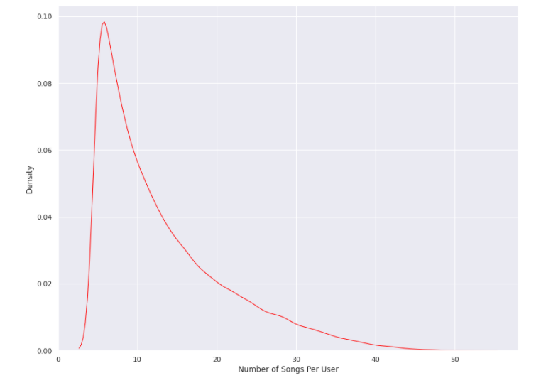
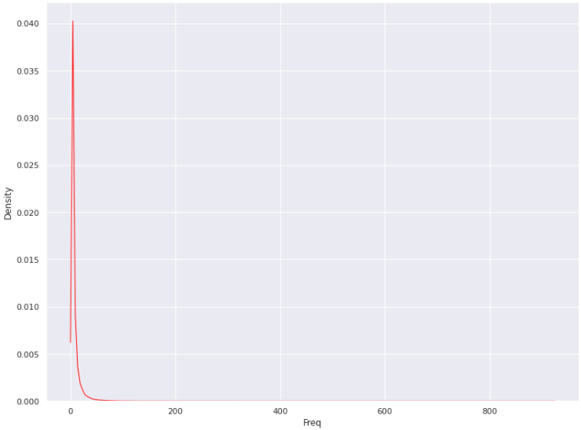
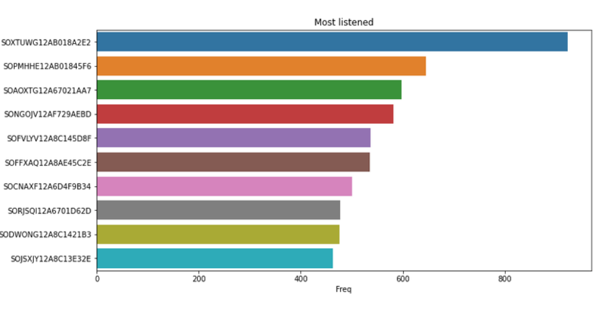
EDA Snapshots
Number of songs listened per user
Distribution of Frequency
Most Listened Songs

Slide 6
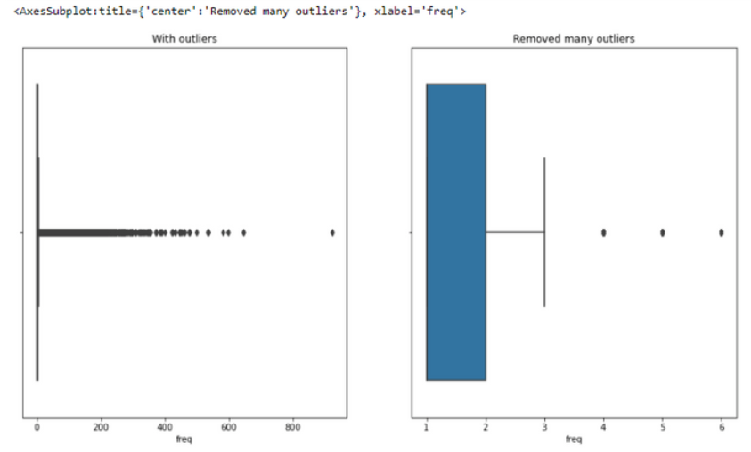
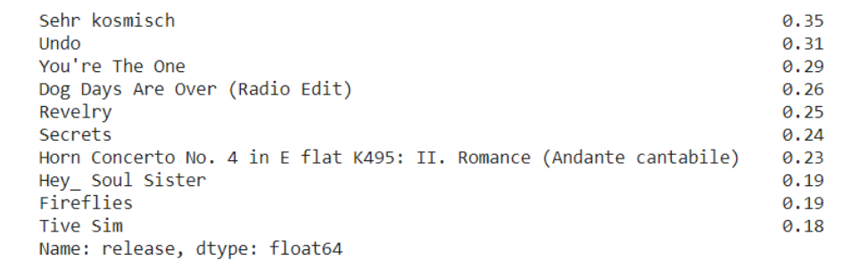
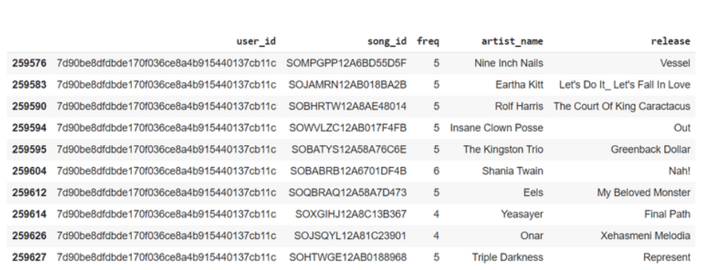
EDA Snapshots
Percentage of top 10 releases and their contribution in the whole dataset.
Outlier Detection
Songs that the user listened to more than 3 times.

Slide 7
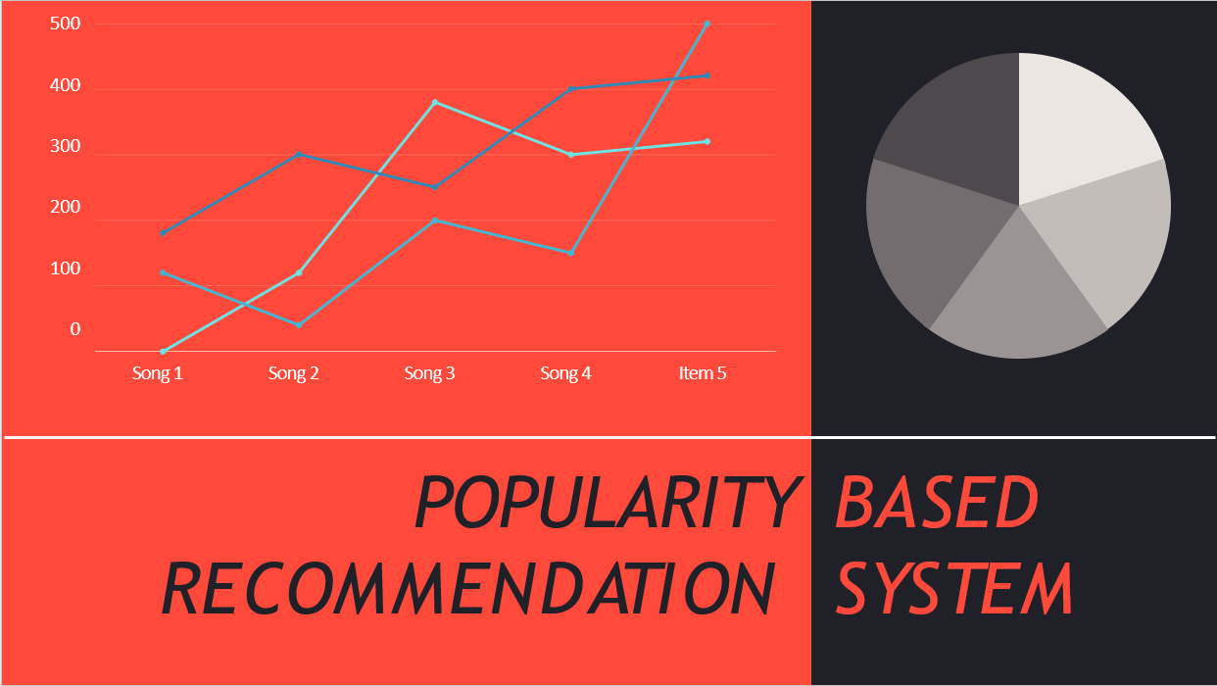
500
400
300
200
100
0
Song 1
Song 2
Song 3
Song 4
Item 5

Slide 8
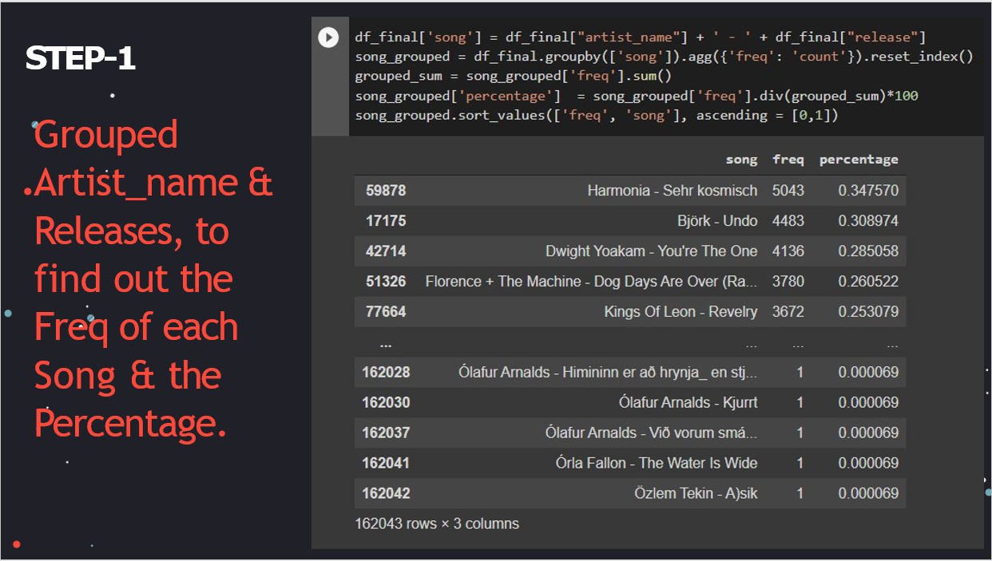
500
400
300
200
100
0
Song 1
Song 2
Song 3
Song 4
Item 5

Slide 9
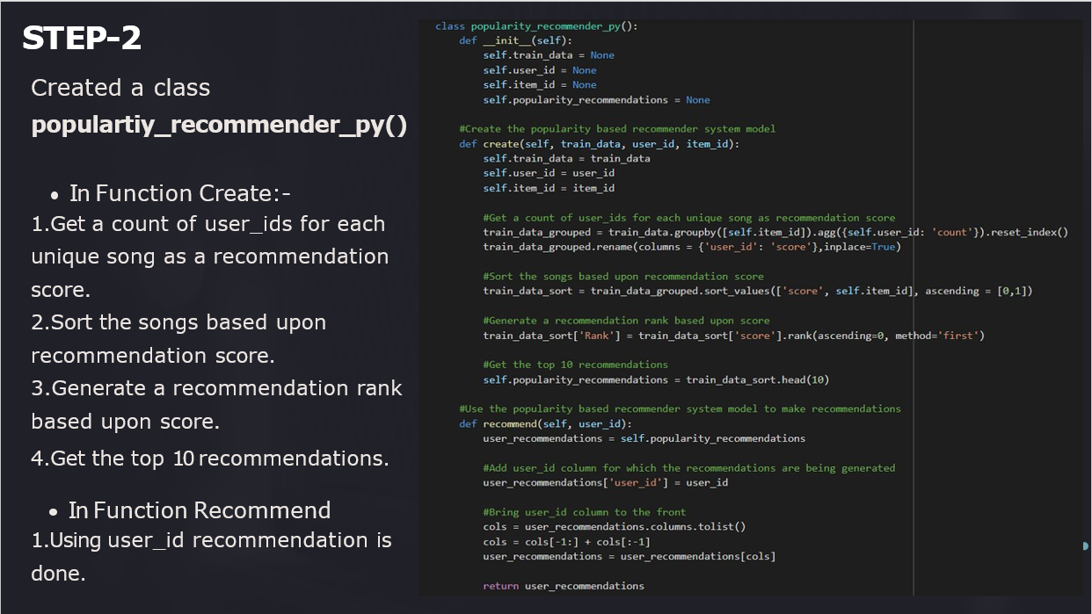
500
400
300
200
100
0
Song 1
Song 2
Song 3
Song 4
Item 5

Slide 10
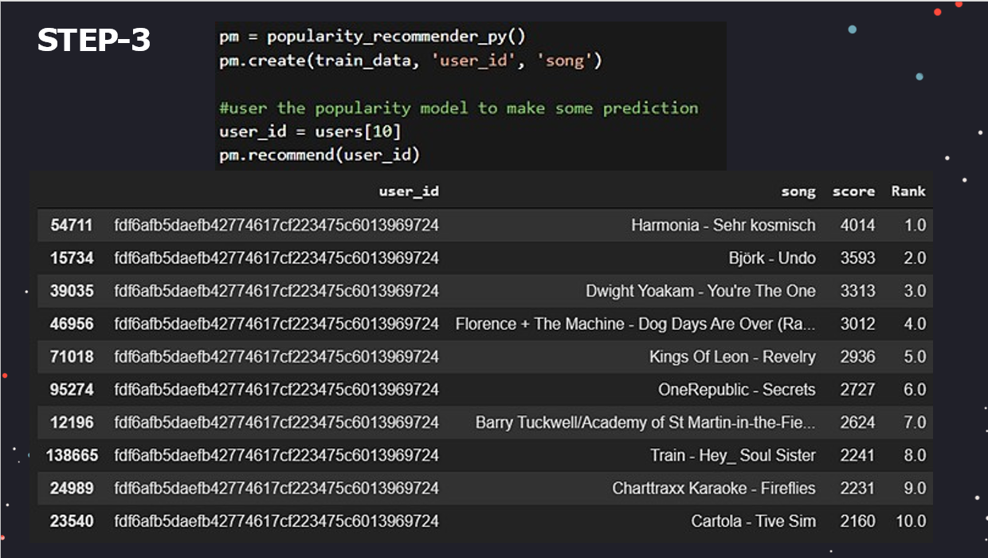
500
400
300
200
100
0
Song 1
Song 2
Song 3
Song 4
Item 5

Slide 11
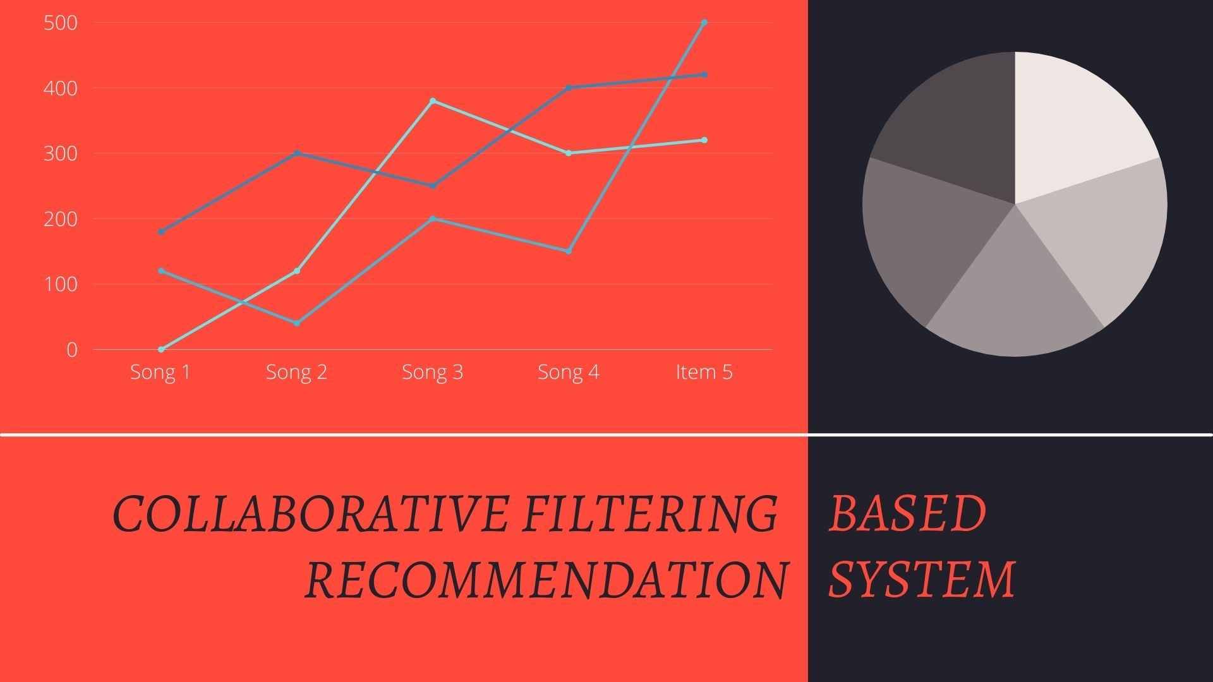

Slide 12
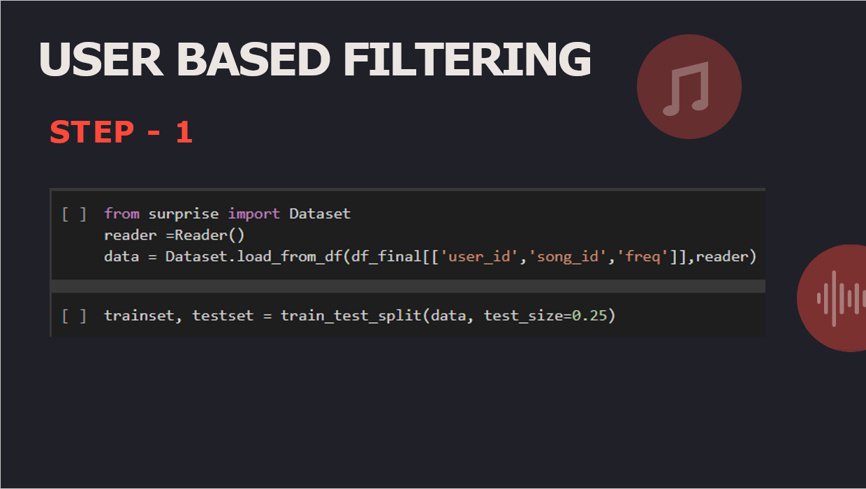


Slide 13
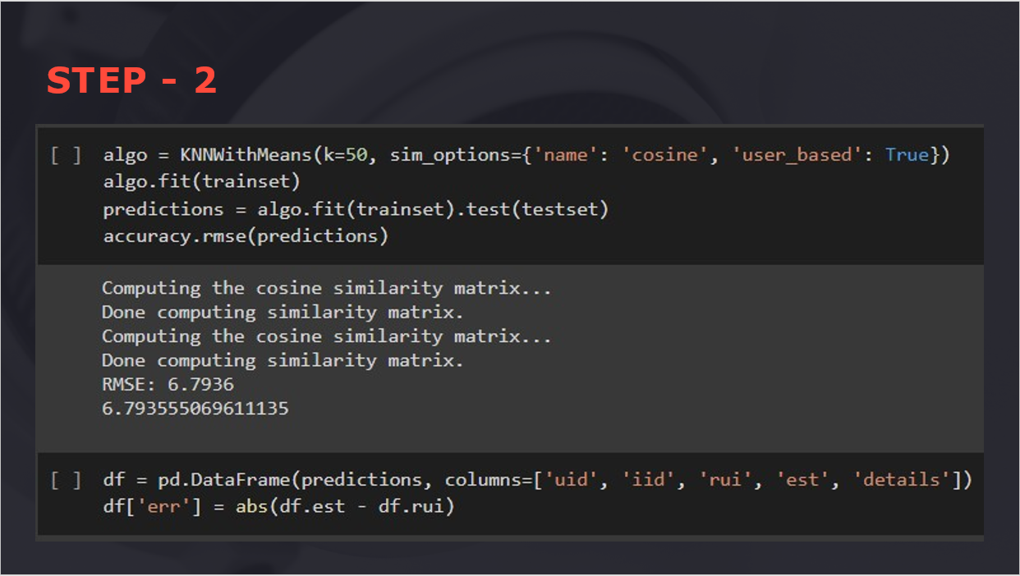
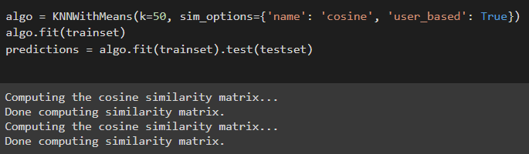

Slide 14
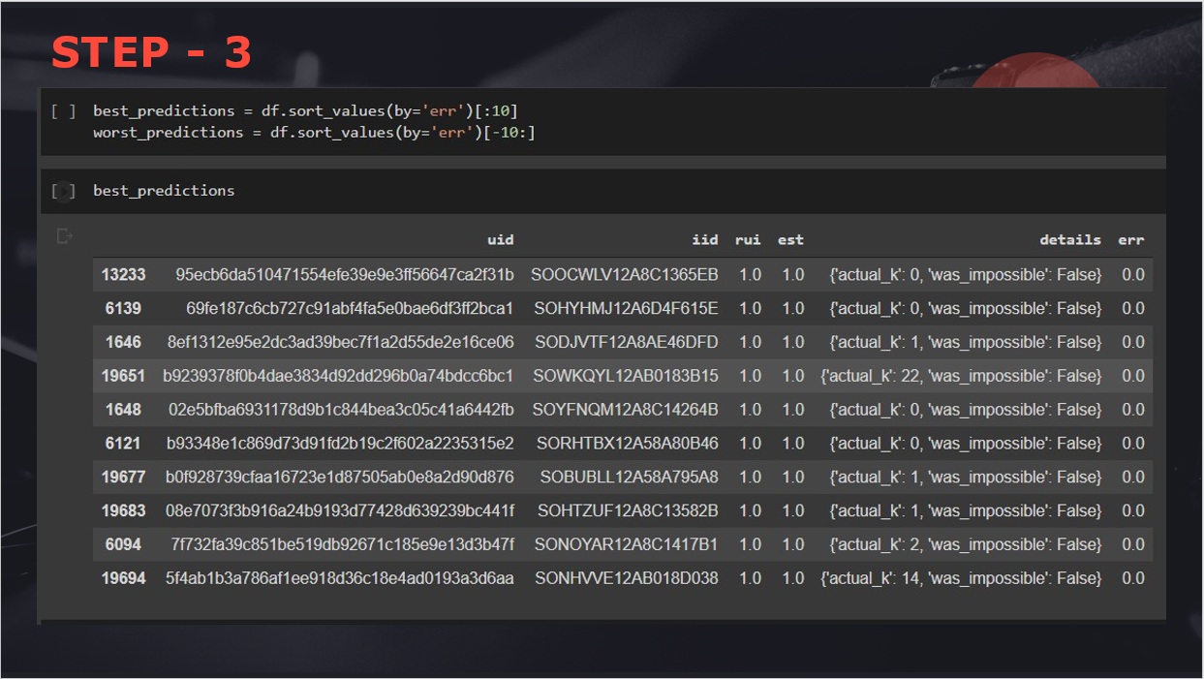

Slide 15
500
400
300
200
100
0
Song 1
Song 2
Song 3
Song 4
Item 5
CONTENT BASED RECOMMENDATION SYSTEM

Slide 16
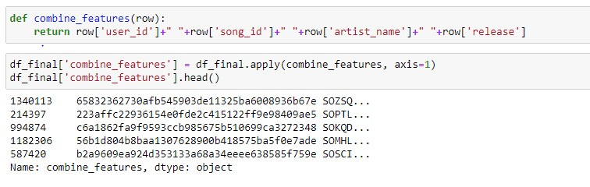
STEP - 1
Combine all columns for getting all the Content-Based information

Slide 17
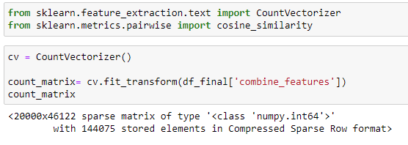
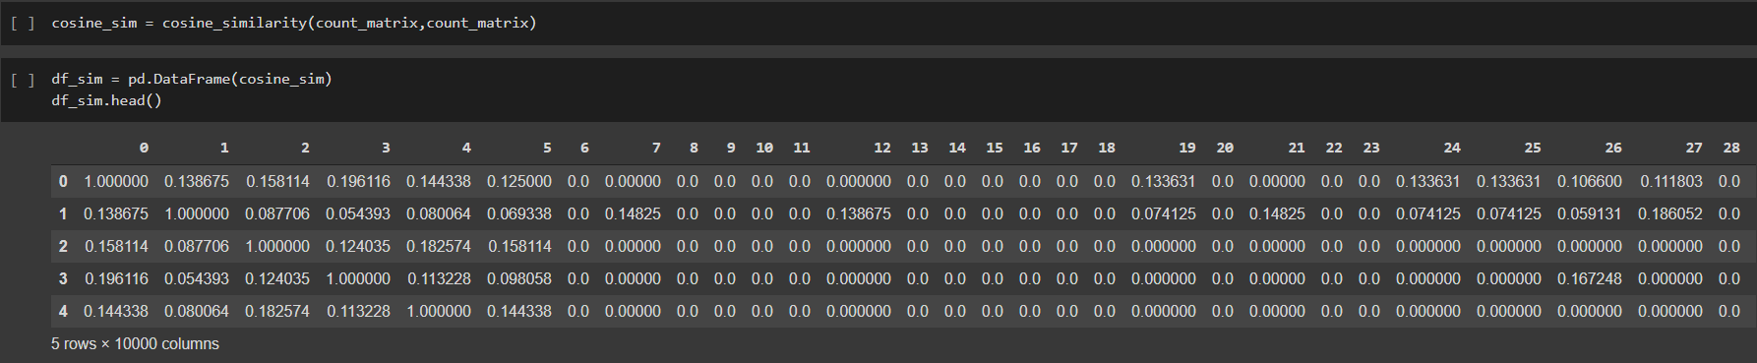
STEP - 2
STEP - 3

Slide 18
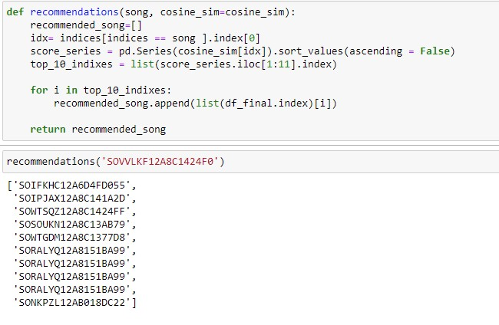
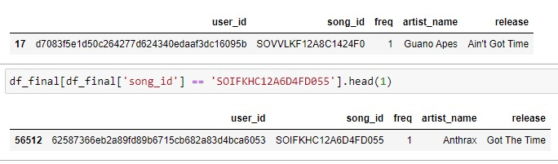
FINAL STEP
Recommendation using the Contact-Based model
Output for song id :
"SOVVLKF12A8C1424F0"
Now, we can clearly see that the recommend song consist "Got" and "Time" form release column our model is predicted good

Slide 19
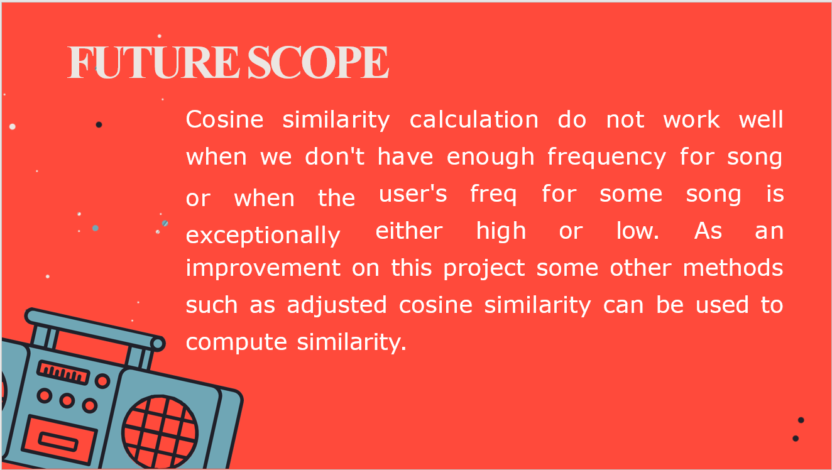


Slide 20









THE TEAM BEHIND THIS PROJECT
ASHISH KUMAR SINGH
IN30180
VINOD NAYAK
IN30032
TEAM 10
AKSHAT KABRA
IN30109
SHAIK HANEEF
IN30170
NARENDER ANNAM
IN30211

Slide 21

THANK YOU

